Slide 1

1. Supply a working blueprint [architecture] & roadmap for Health Service Analytics Innovation 2. Set requirements for data de-identification framework and standard operating procedures that operationalize that framework
Target Information Architecture (TIA) – to satisfy twin task demands:
PART 1 TARGET INFORMATION ARCHITECTURE
Adapted from: presentation to the Pan Canadian
Enterprise Architecture Community of Practice (June 18, 2019)
July 11, 2019
Kenneth A. Moselle, PhD, R.Psych.
Director, Applied Clinical Research Unit, Island Health
Adjunct Assoc. Professor, University of Victoria
Co-Founder – Data Science Studio
Andriy V. Koval, PhD
Assistant Professor
Health Management & Informatics
University of Central Florida
Co-Founder – Data Science Studio

Slide 2
This presentation represents Part 1 of a set of documents concerned with two related challenges:
Part 1 - Target Information Architecture - derivation of products from health service data that are sufficiently statistically/methodologically robust and targeted that they at least warrant consideration as candidates for translation back to a health service system.
Part 2 – Data De-Identification - disclosure/access management of source health service data to those parties/team who are likely to possess the requisite combinations of clinical content domain knowledge and statistical/analytically expertise required to generate useful/usable products.
In effect, Part 1 sets out the requirements for Part 2 – the methodology covered in Part 2 must scale out to the types of datasets required to generate the products covered in Part 1.

Slide 3
Organization of the two presentations
PART I – Target Information Architecture for Health Service/Service System Analytics
Why might we want to promote the use of target information architectures (TIA) in supporting a health service analytics innovation agenda?
Example of a TIA for health service analytics
PART 2 – Data-Requirements-Informed Data De-Identification Scheme [separate presentation]
Why would the analytics innovation agenda be concerned with data de-identification?
Target information architecture as the basis for systematically “stress testing” a data de-identification methodology
Distinctive privacy challenges associated with transactional data extracted from clinical information systems
Data disclosure privacy risk model that scales out to high-dimensional health datasets (e.g., datasets extracted from clinical information systems)
Data de-identification workflow – high-level
Critical role of shared understanding and consensus around data de-identification – a ‘fractal’ data de-identification model.

Slide 4
Part I Target Information Architecture: Why?

Slide 5
Why employ an information architectural approach to analytics innovation?
So the necessary pieces (a) exist; and (b) fit together (into conceptual models; into statistical models).
Relevance and impact - so the assembled analytically-derived ‘objects’ are fit for purpose and fit for context (i.e., targeting)
Analytical ‘orphans’ – e.g., process metrics (causes) not related to outcomes (effects); or effects not related to causes = diminished utility.
Analytical gaps, e.g., essential risk-adjustments missing from models → ambiguous relevance.
“Jumping to metrics” vs building to architectures – merits/demerits of different approachs
Information dependencies dictating sequencing for analytics innovations
Pushing off difficult-to-construct analytic entities to a time when we are not so busy – when might that be?
Provide a reference model for analytics innovation strategy and tactics and plans – and resources and environments and partnerships.
Provide a wire-frame within which data sources, information products and information-dependent functions can be catalogued and tracked.
Notes:
d

Slide 6
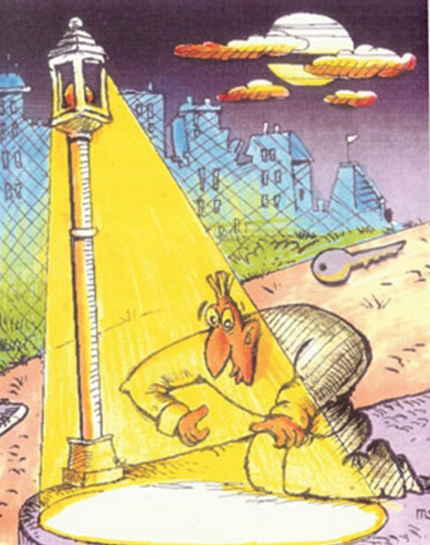
Illustrative example – working with data contents we have vs what we need
The streetlight effect, or the drunkard's search principle, is a type of observational bias that occurs when people only search for something where it is easiest to look. https://en.wikipedia.org/wiki/Streetlight_effect

Slide 7
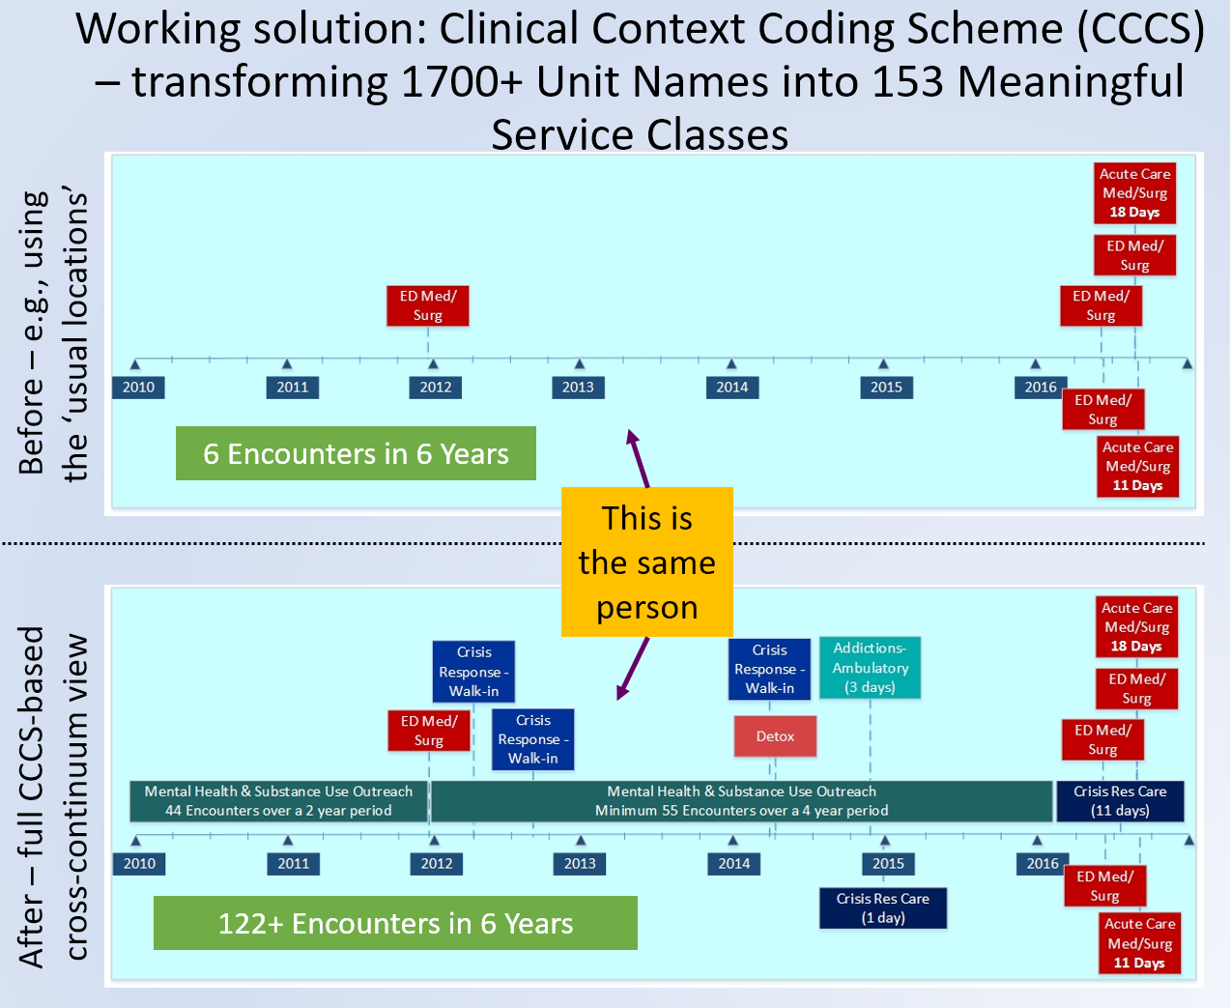
Measurement based on what is readily accessible vs measuring based on a working model that describes essential features of what you are trying to measure
Prediction models based on the upper figure would be incorrect; estimates of demand for services to meet population need would not reflect the profiles of at-risk or affected populations.

Slide 8
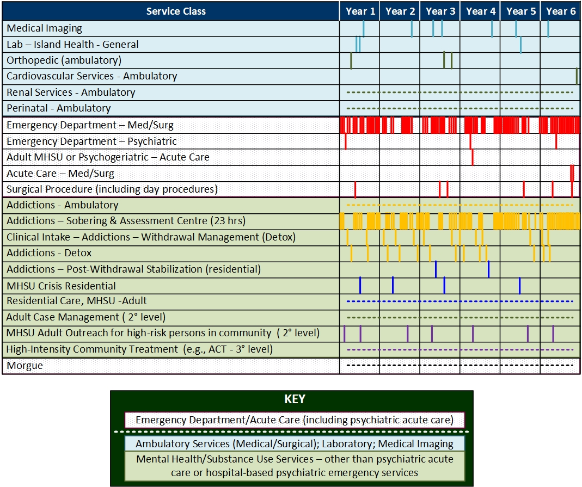
Service Terrain Navigated by a Prototypical
High Risk/High Needs Person Contending with Chronic/Recurring Mental Health & Substance Use Issues
Within-person-over-time visualization of a single patient/client “journey”
Goal: generate useful information products from datasets that reflect the full “patient” journey.
Approach: We may initiate this analytical work with contents that are readily available (under the streetlamp) from most provider systems (e.g,. ED-plus-Acute-Care data). To meet the goal, our target information architecture must understand the full “journey”. It must be built around the full suite of data ‘traces’ that are created as the person navigates the terrain.

Slide 9
Target Information Architecture
a working example

Slide 10
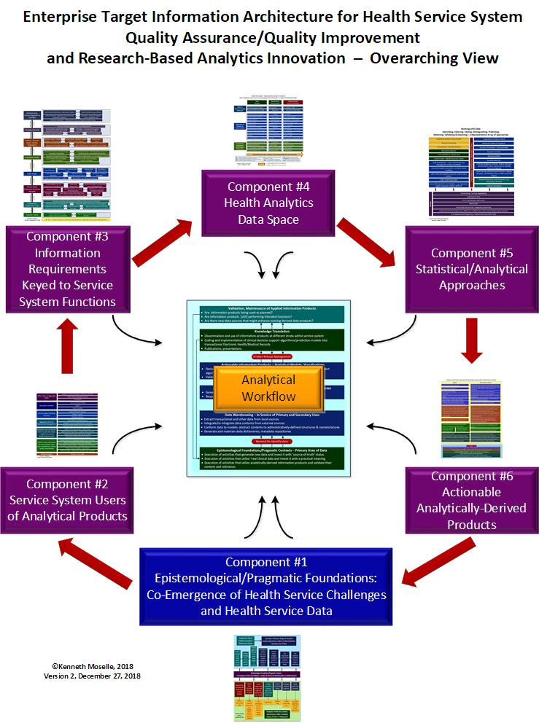
Target Information Architecture

Slide 11
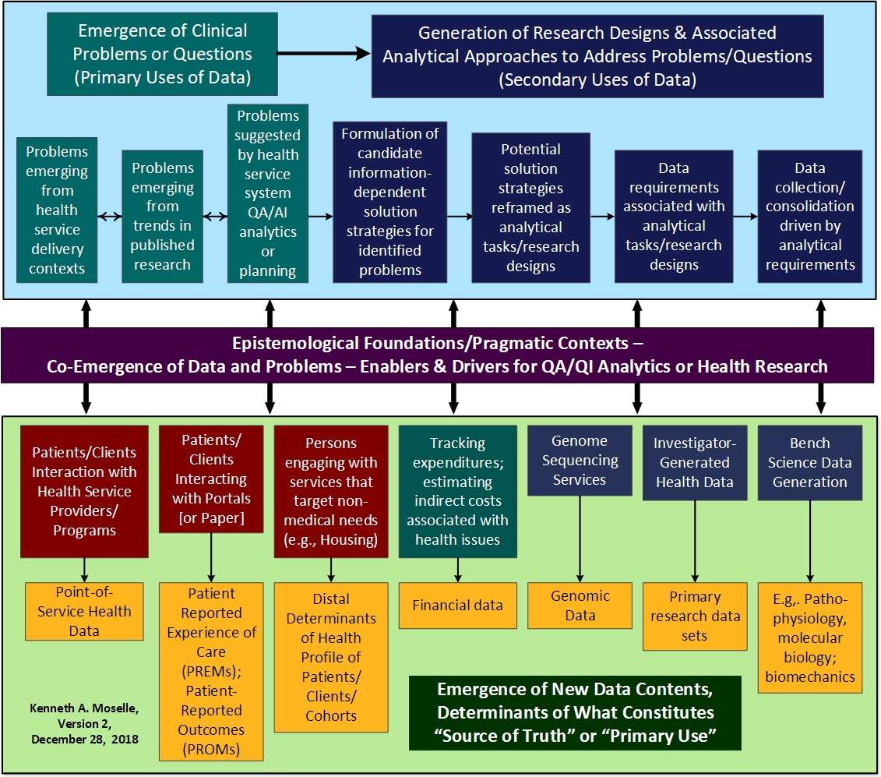
Component #1 - Epistemological Foundations – where does analytically useful health information originate?
Epistemology – concerned with sources/emergence of knowledge.
Where does knowledge of clinical/health risk, need and outcome originate?
If we want our analytically-derived information products to interact constructively with processes at points of service – where MUST at least some of the knowledge originate??
If we want to address issues using information, where must we target our analytically-derived products? And, what form should those products take??
“Out of nothing shall not come something” – words allegedly spoken by Heinz Werner (Werner & Kaplan – Symbol Formation, 1984)

Slide 12
Highlighting data contents/deliverables within the architecture based on three key data sources and consumers of analytical products – community-derived (including primary care); health-authority-derived; Ministry of Health derived
Three key data sources and information consumers:
Community services - including primary care, and data generated directly by patients/clients
Health Authority – secondary, tertiary services
Ministry of Health – administrative data, with norm-references (e.g., Expected Length of Stay)
In this section, some key components of the TIA are presented twice.
The first presentation of each component is intended to highlight the architecture of the entity in question. (e.g., slide #12 – “Service System Users of Information Products”). It also catalogues key contents associated with architectural elements.
The second presentation of a component is intended to highlight features of the component that relate to the three key data sources and consumers of information (community services; Health Authority; Ministry of Health) – colour-coded as indicated above.

Slide 13
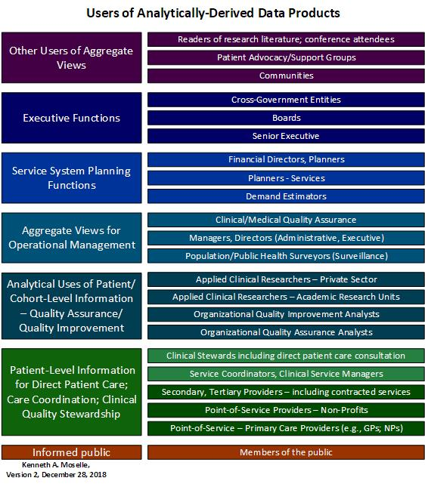
Component #2 - Service System Users of Information Products

Slide 14
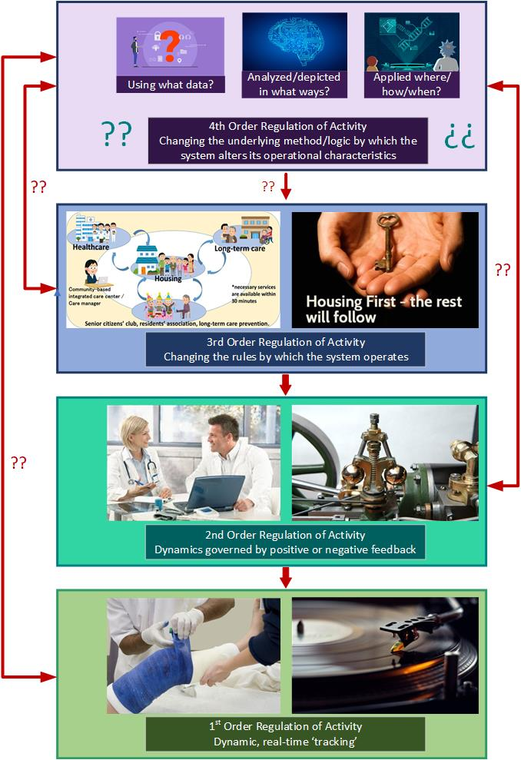
Deeper structure to Component #2 – a basic General Systems Theory framework
4th-Order –new approaches to analyzing information; dynamic regulation of activity in real time using ALL data
3rd-Order -Getting the system out of the usual groove
Note Coupling of Two Dynamic Sub-Systems – Important!
2nd-Order – reducing variation via information-based feedback mechanisms
Governor on a steam-engine
1st -Order – dynamic regulation of activity in real time using a narrow slice of here-and-now data
In the groove
Notes:
d

Slide 15
Service Systems – 1st, 2nd, 3rd Order Users of Information Products

Slide 16
Service System Users of Information Products
Community
Health Authority
Ministry of Health

Slide 17
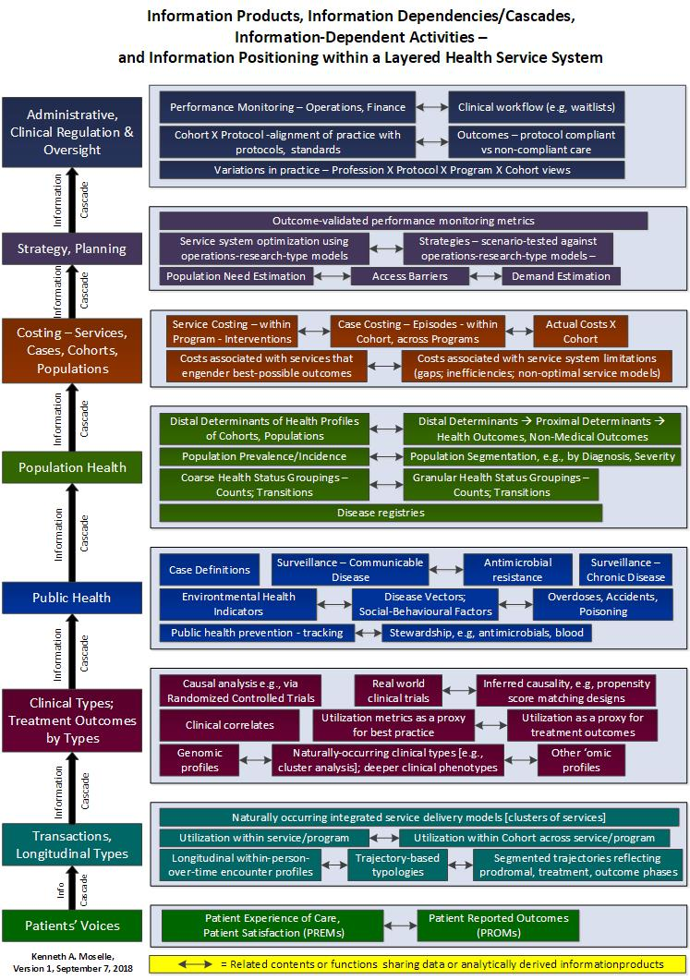
Component #3 - Information Products Positioned within a layered Health Service System – which information-dependent functions REQUIRE which products/analytical tools?
Notes:
d

Slide 18
Information Products/Tools Positioned within a Layered Health Service System
Community
Health Authority
Ministry of Health
Notes:
d

Slide 19
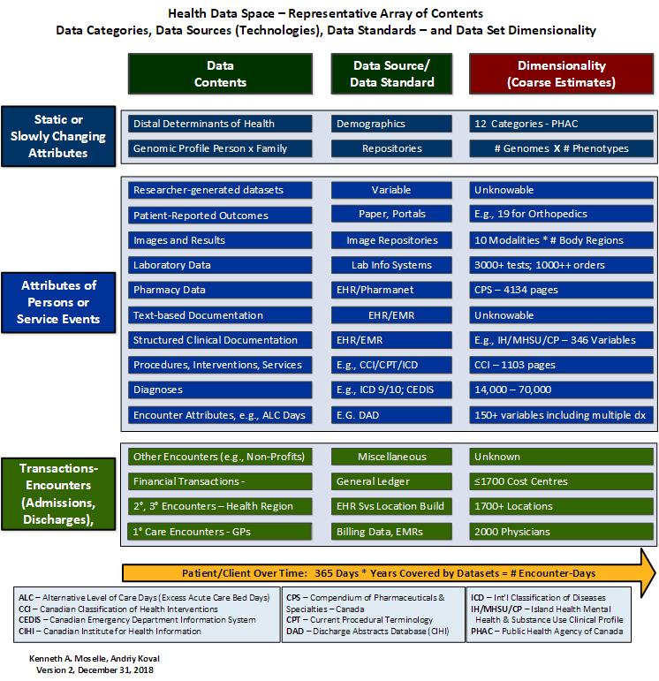
Component #4 - What data?

Slide 20
What data – broken out by community/health authority/ Ministry of Health
Community
Health Authority
Ministry of Health

Slide 21
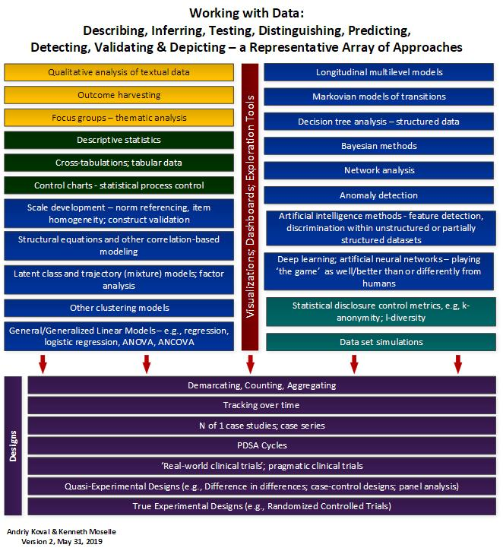
Component #5 - Statistical/Analytical Approaches
These are not clearly “owned” by any sector or strata within the full array of entities we may call the health service system – so unlike the other components, they are not marked according to “owner” or “stakeholder”.

Slide 22
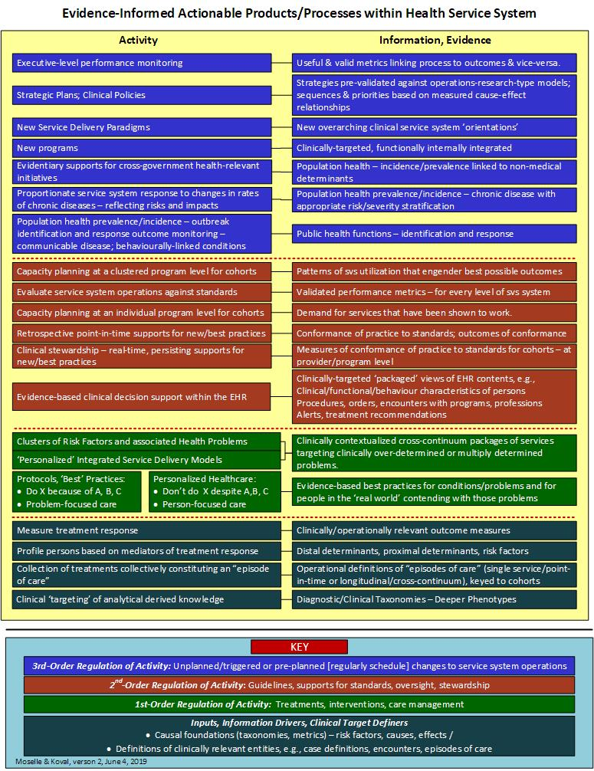
Component #6 – Actionable, Analytically-Derived Products

Slide 23
Component #6 – Actionable, Analytically-Derived Products

Slide 24
Putting the TIA to use: Using the TIA as a framework for characterizing and cataloguing the deliverables associated with a program of research focused on MoH Minimum Reporting Requirements (MRR) for Mental Health & Substance Use

Slide 25
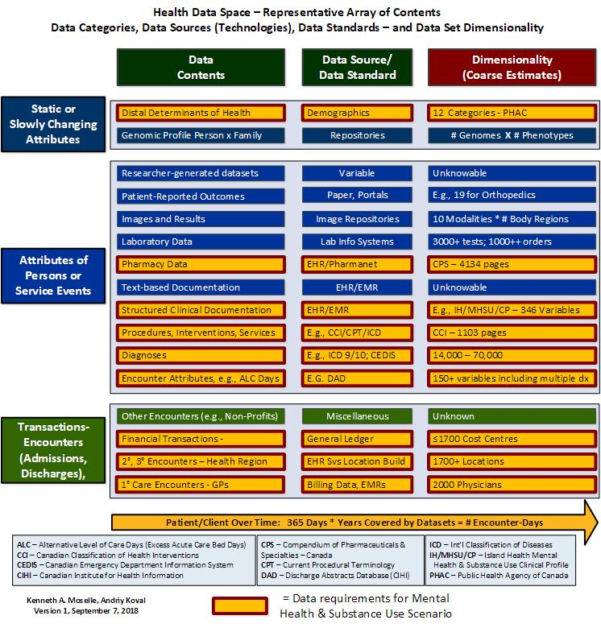
Data Space – program of research concerned with high risk/high needs Mental Health & Substance Use Clients

Slide 26
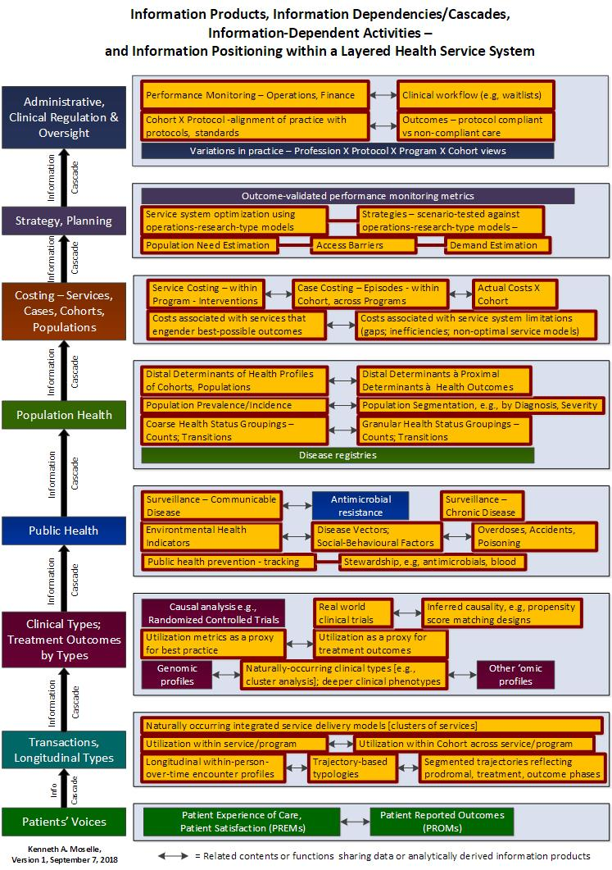

Slide 27
Discussion, Summary: Some TIA framework principles; some TIA facts of life

Slide 28
Where are some key limitations of the existing model
It treats “executive level functions” in an undifferentiated way – but this ‘level’ is the core or foundational ‘business’ for a Ministry that does not deliver services directly.
Divisions (interacting laterally) within a layer in a hierarchical structure, e.g., 1700+ programs that collectively constitute the ‘clinical business end’ of island Health. These cluster into a smaller set of entities which are not homogeneous with respect to information generated or used.
Risk management functions and associated information requirements.
Primary care – the model does not go very far into the primary care end of the service continuum. That is a problem!
The model does not envision or spell out uses of derived information products by patients/clients (e.g,. via portals).

Slide 29
Framework, Principles
#1: General Systems Theory (GST – von Bertalanffy) – complex system = hierarchically-ordered array of interacting regulatory mechanisms – exchanging information with an environment
#2a: Law of requisite variety (see Ashby) – why information MUST roll up from the points-of-service if adequately informed executive-level system regulations are going to roll back down
#2b: Law of minimal granularity – roll up no more detail than is necessary for intelligent control to roll back down (converse of #2a)
#3: “Structural engineering” building code for load-bearing “multi-story” analytics that maps onto layered structure of an organization
Epistemological foundations – source of clinical meaning and utility
Data dependencies
Structural properties of useful information
Validity – ready for clinical prime-time – the concepts of “research-grade” and “clinical-grade” information
#4: Architectural dependencies – transactional foundations of everything; administrative data are derived entities
#5: Coupling (reciprocally-reinforcing transactions): exposure to information does not necessarily accomplish work; coupling via the intermediary of information puts information to work.
Between information and a single recipient of care – one key, one lock
Between providers, programs and cohorts – several doors, multiple keys
Between strata within an organization – different floors, different access between levels
Between organizations – different buildings
#6: Information ‘highways’ are only a part of the information road system
Local roads vs logging roads vs superhighways – each have their place and time and function
Roads to nowhere – untargeted analytics
Notes:
d

Slide 30
Facts of Life
Transactional data and “administrative data” are not equivalent (even when you have a lot of longitudinal administrative data).
Time matters – between outcome and events that engender those outcomes or dynamics that regulate those events – why the eyes are in the head!
Persistence – sustained streams of information (driving requirements around reproducible paradigm, information streams, vs one-off injections of insights) – if you want your analytics to do constructive work.
Single cause, single treatment → simpler statistical models (though not THAT simple if we want to look at people over time)
Multiple causes, risk factors → multivariate models, undeniably complex
Unknown causes, unknown effects → iterative approaches
Voyage of statistical discovery – using old and new tools
Validation – using classic approaches
7. Therefore – partnerships between holders of data and holders of analytical expertise (and environments that enable those twains to meet).
8. This means we have to have processes that expose data (but not data subjects) to people who can analyze the data and generate useful products.
Notes:
d

Slide 31
Part II Data Disclosure Privacy Risk Model – Creating Relationships Between Health Data and Parties with Analytical Expertise (see Component #5 of Target Information Architecture) Basis for a ‘Real World’ Contextualized Data Disclosure/Data De-Identification Methodology Introductory Material

Slide 32
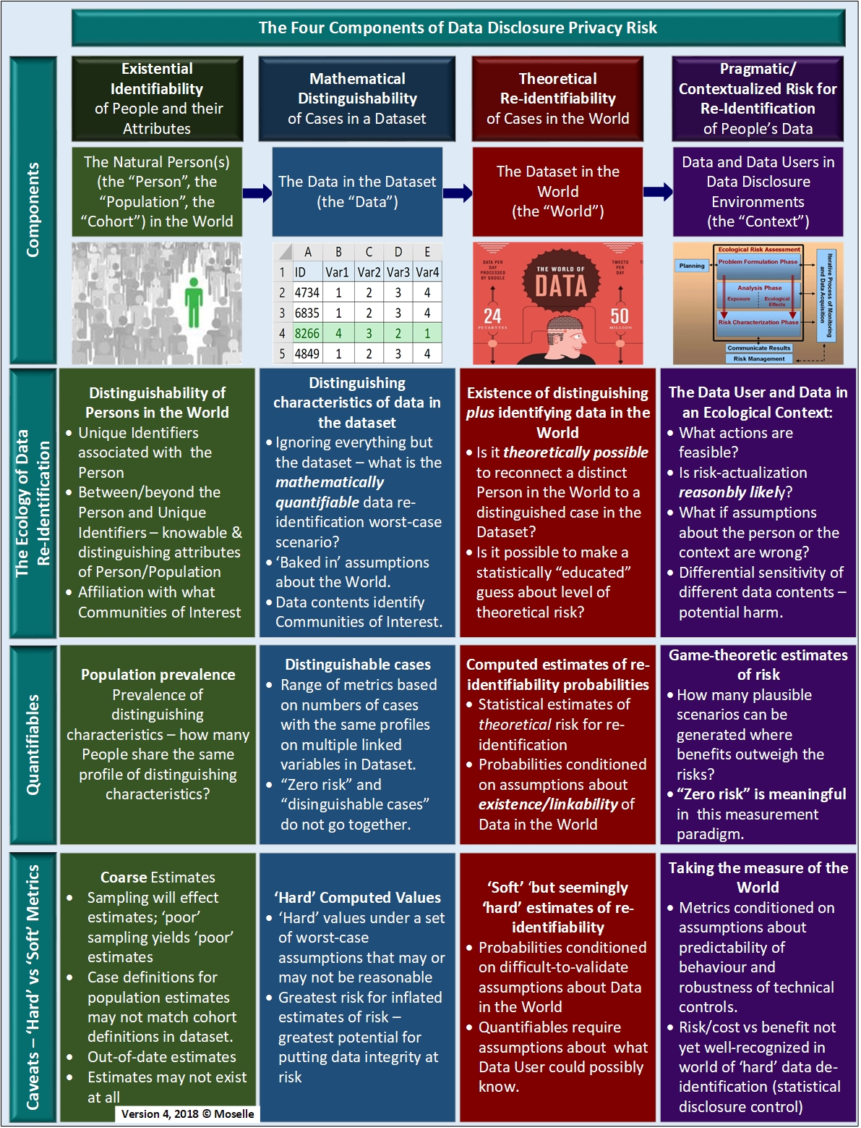
Data Disclosure Privacy Risk Model

Slide 33
Four components that collectively specify the risk profile of a candidate data disclosure – and provide an anchoring-point for operational definitions of key constructs (e.g., “de-identification”; “limiting disclosure”; “risk”)
Component #1 - People in the world – with attributes that need to be preserved (e.g., response to treatment) in the data as disclosed, while preserving the privacy of the people associated with those attributes.
Component #2 – Mathematical distinguishability of cases in the Dataset – without which there is no privacy risk associated with the disclosure – the data ‘”space”.
Component #3 – Dataset in “data space” meets data in the “real-world” – from “distinguishability” to “theoretical re-identifiability”.
Component #4 – Logistical/pragmatic features of the disclosure – how feasible and likely is it that someone will perform the actions required to transform theoretically re-identifiable contents into re-identified contents?

Slide 34
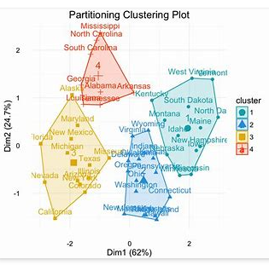
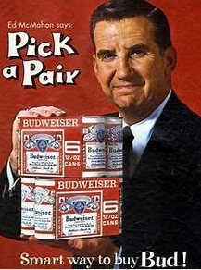


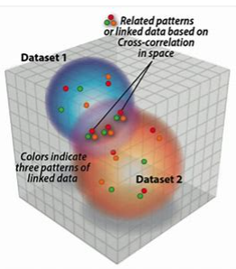
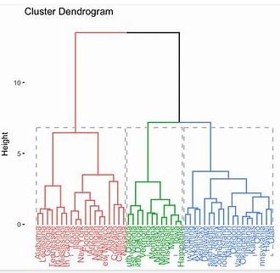



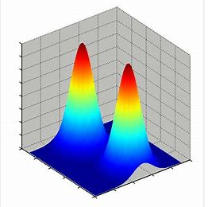

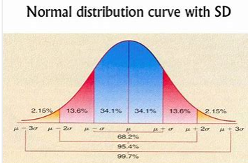

If only it were as simple as finding one key – anywhere!

Slide 35
For more information, please contact:
Kenneth A. Moselle, PhD, R.Psych. Director, Applied Clinical Research Unit Island Health British Columbia kenneth.moselle@viha.ca
250-812-3925

